Slide 1
A PULSE ON THE TOURISM WORKFORCE:
Knowing the People that Drive the Sector Forward

Slide 2





Who we are and what we do
Innovation, Science and Economic Development Canada’s Tourism Branch works diligently to:
Support informed and data driven recommendations in departmental products
Collaborate with internal and external stakeholders on potential research initiatives
Work with stakeholders to identify data improvements that benefit the sector and to expand tourism data availability.
Coordinate with Statistics Canada and Canadian tourism-related organizations (Destination Canada, THRC, etc.) to access key tourism datasets that provide insight on economic and labour market impacts for the sector.
Develop and distribute products that provide a summary/analysis of relevant statistical data.
These include regular and ad-hoc products that provide insight on emerging and nascent trends and issues in the tourism sector and related industries.
All this results in our goal of:
Supporting our Minister in advocating for the importance of Tourism sector to the Canadian economy.
Providing this support through objective and evidence-based analysis providing accurate messages which respect data integrity. This includes bringing a neutral lens, and vetting data for credibility, reliability and comparability.

Slide 3
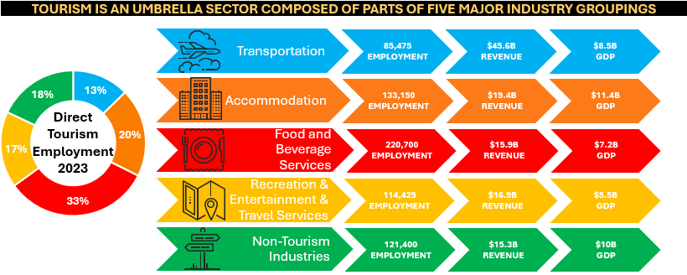
Defining the Tourism Sector
Tourism is a unique sector in the Canadian economy because of how it is defined.
It is often referred to as an ‘umbrella sector’ composed of a mix of industries and parts of industries and the various products they produce.
A tourism-related industry is defined as one that would exist at a reduced level without tourism’s presence.
Some industries are included as tourism-related even though much of their output can be attributed to non-tourism activities (ex., the food and beverage services and, recreation and entertainment industries).

Slide 4
Defining the Equity-seeking Groups
Groups underrepresented in Canada’s labour market include women, youth, Indigenous Peoples, newcomers, racialized groups, people who identify as 2S/LGBTQ+, and persons with disabilities.
These groups also tend to be among the least well served by training and employment programs.
Knowing how these groups, and the intersectionalities therein, figure in the tourism sector can help better understand barriers to these equity-deserving face, serve this potential labour force and help the tourism sector address labour concerns.
Presentation Goals
Innovation Science and Economic Development Canada will present how it makes use of Tourism Labour Statistics to provide a breakdown of the workforce in tourism industries.
The breakdown, by industry, geography and, most significantly, demographics, provides insight on the level of representation of specific equity-seeking groups in tourism industries.
Through our multiple products, we paint a broad picture of the tourism workforce in Canada, in which we can identify our strengths and areas of improvement relative to other industries.

Slide 5
HIGH LEVEL TOURISM LABOUR FORCE STATISTICS

Slide 6
TOURISM SUPPORTED
JOBS
- RURAL (%)
TOURISM SUPPORTED JOBS
TOURISM DIRECT
JOBS
2.02
million
2023
692,125
10.7%
2.07
million
2024
702,650
10.5%
0.2
percentage points
Y-o-Y Change
2.5%
1.5%

Slide 7
TOURISM SUPPORTED
JOBS
2024
Industries
Regions
Tourism supported
2.07 million jobs (about 10% of Canadian employment),
almost 2.1% more than 2023.
18%
45%
28%
7%
2%
2.1%
 | Food & Beverage |  | Transportation
 | Recreation & Entertainment |  | Accommodations
 | Travel Services

Slide 8
TOURISM WORKFORCE
AGE DEMOGRAPHICS (%)
TOURISM WORKFORCE DEMOGRAPHICS (%)
YOUTH (AGE 15-24)
YOUTH (AGE 15-24)
2024
32.8%
2024
32.8%
CORE (AGE 25-54)
WOMEN
2024
51.3%
2024
48.1%
SENIOR (AGE 55+)
IMMIGRANTS
2024
15.8%
2024
32.4%

Slide 9
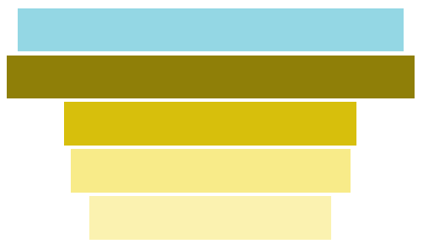
2024 TOURISM AVERAGE HOURLY WAGES BY INDUSTRY
Economy Average
$30.26
Transportation and Warehousing
$31.48
Arts, Entertainment and Recreation
$23.14
Accommodation
$21.29
Food and Beverage
$19.18

Slide 10
TOURISM BUSINESSES
2023
243,274
5.5%
of all Canadian businesses
9.2%
Y-o-Y increase
2024
265,841
TOURISM BUSINESSES
- SMEs(%)
2024
99.9%
TOURISM BUSINESSES
- RURAL(%)
2024
12.9%

Slide 11
TOURISM WORKFORCE PRODUCTS

Slide 12
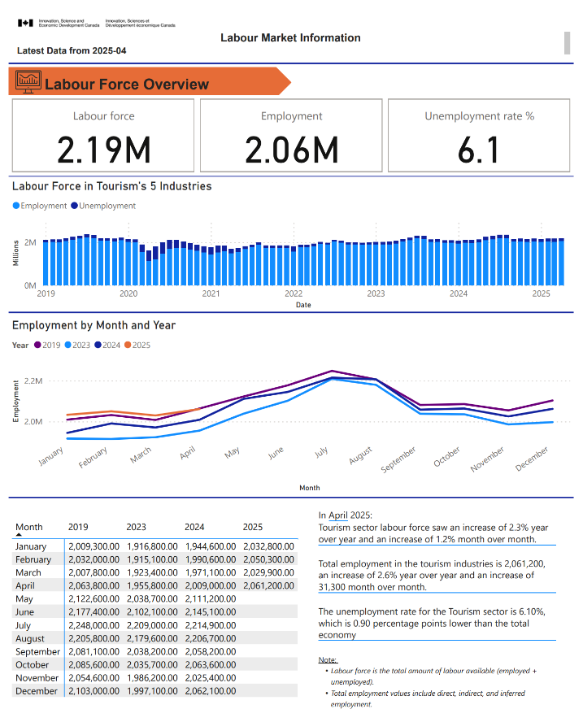
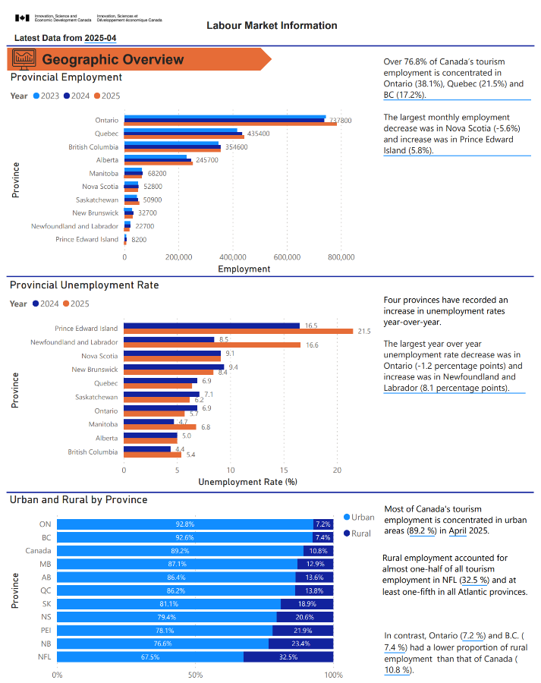
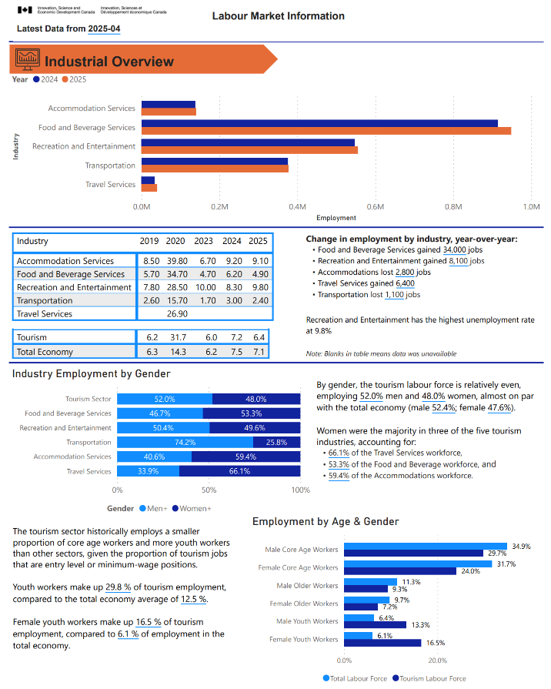
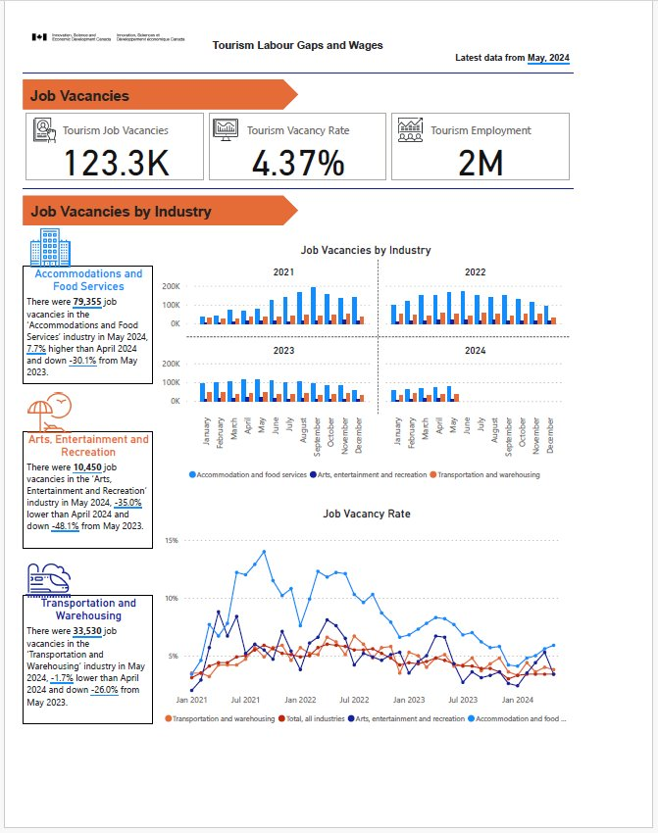
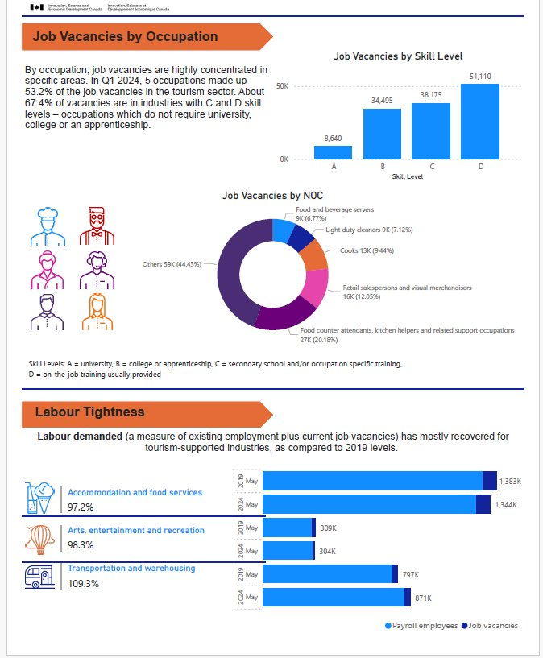
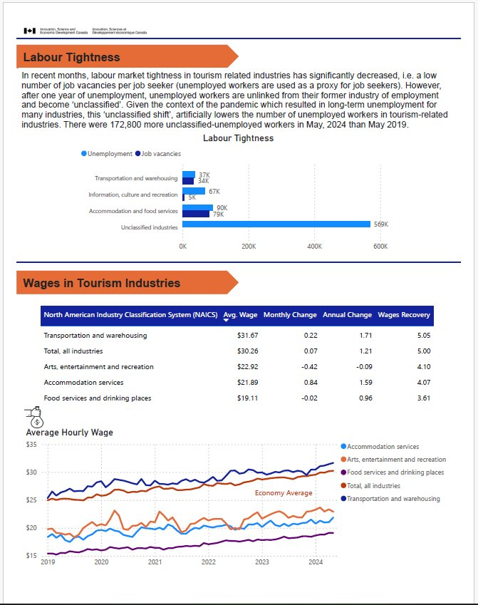
Tourism Labour Market Information –
Labour Market Report / Labour Demand and Wage Report
A monthly analytical document which details the current labour market intelligence for Canada’s tourism industries specific to the labour force.
A quarterly analytical visual report which details the current labour market intelligence for Canada’s tourism industries specific to Job Vacancies, Labour demand, and Wages

Slide 13
TOURISM WORKFORCE PRODUCTS
EQUITY SEEKING GROUPS INFOGRAPHICS

Slide 14
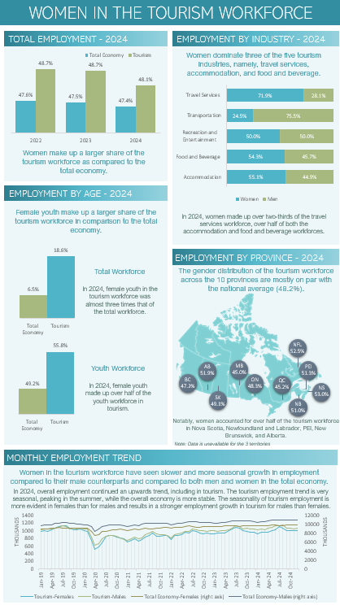
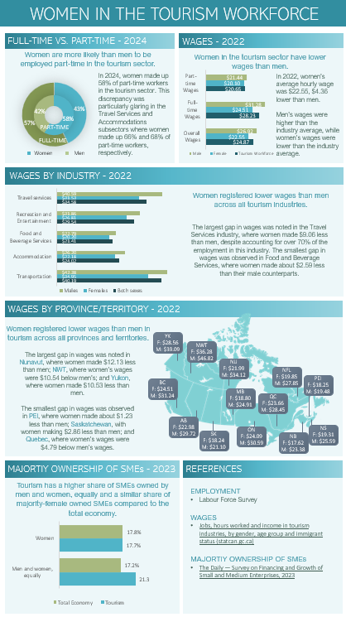
Infographics on Equity-Seeking Groups in the Tourism Labour Force
Women in Tourism - Highlights
Women employed in the tourism sector in 2024 declined slightly from 2023 yet generally remained consistent in the total economy.
In 2024, women continued dominate travel services, food and beverage, and accommodation employment as in 2023, but now consisted half of the employment in Recreation and Entertainment.
In 2024, female youth employed in tourism remained fairly consistent with 2023 levels.
In 2024, as in 2023, women employed in tourism by province remained mostly on par with the national average.
In 2024, Women continued to be more likely than men to be employed part time in the tourism sector and remained less likely to be employed full-time.
13

Slide 15
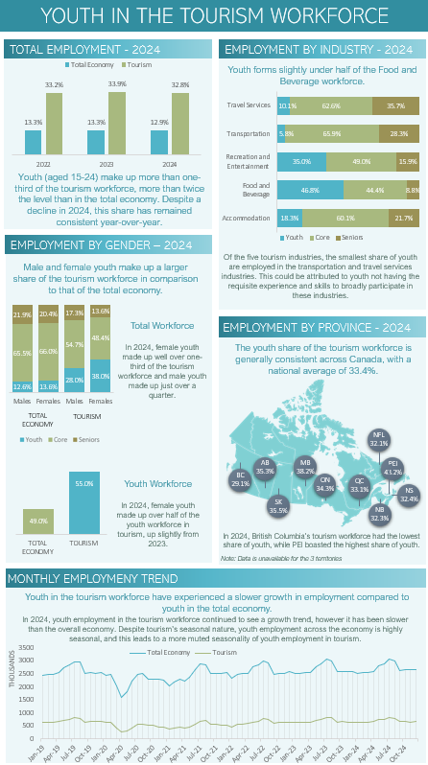
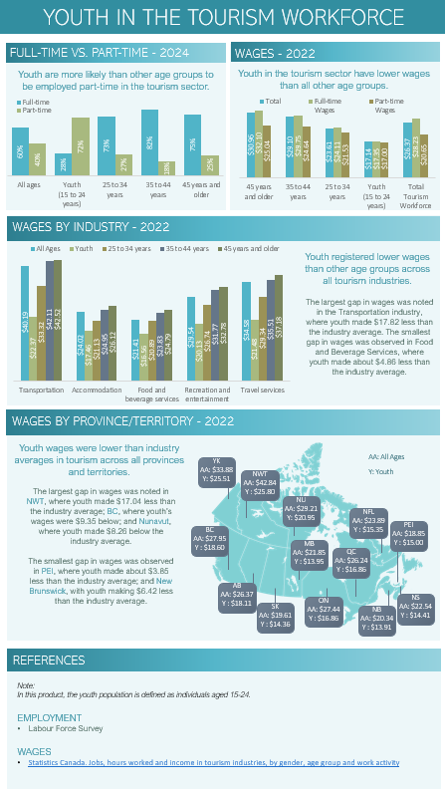
Infographics on Equity-Seeking Groups in the Tourism Labour Force
Youth Workers in Tourism
Youth employment in the tourism sector decreased in 2024 from 2023, while remaining consistent in the total economy.
  In 2024, youth employment in Food and Beverage industry decreased from 2023 yet was still almost half the industry’s employment.
  Youth employment increased year-over-year by 3.2 p.p. in the Recreation and Entertainment industry to account for over one-third of the industry’s total employment.
In 2024, youth employment by gender remained fairly consistent with the levels in 2023, with female youth accounting for over one-third of the overall female workforce in tourism and over half of the youth working in tourism.
In 2024, the youth employment by province jumped to above the national average in seven of ten provinces..
Youth continued to be more likely than other age groups to be employed part time in the tourism sector.
13

Slide 16
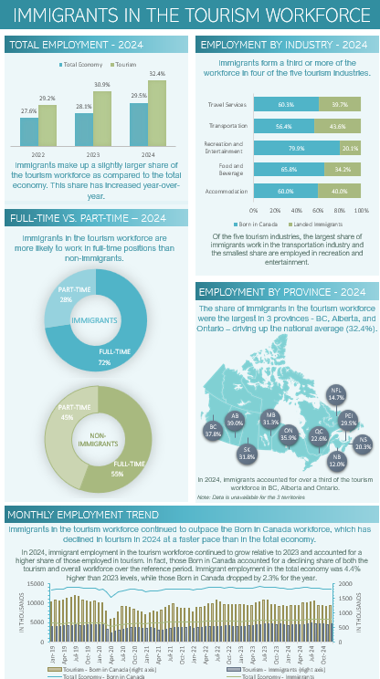
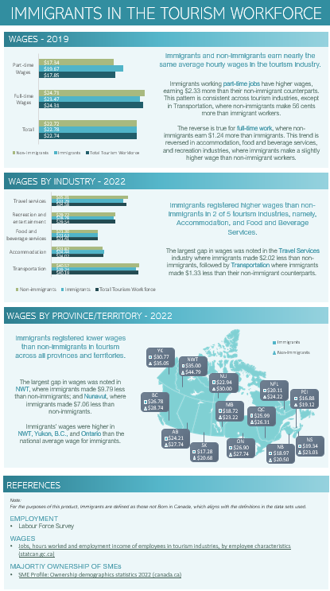
Infographics on Equity-Seeking Groups in the Tourism Labour Force
Immigrant Workers in Tourism
Immigrants employed both in the tourism sector and the total economy continued to increase in 2024 from 2023 and 2022, yet the increases were at a faster pace in the tourism sector.
In 2024, immigrants represented over one-third of the workforce in four of five all tourism industries except Recreation and Entertainment, consistent with 2023 figures.
All tourism industries saw an increase in the share of immigrant employment relative to 2023.
In 2024, as in 2023, immigrant employment was above the national average only in BC, Alberta and Ontario.
In 2024, immigrants in the tourism workforce continued to outpace the non-immigrant workforce, yet they were still more likely than non-immigrants to be employed part time in the tourism sector.
13

Slide 17
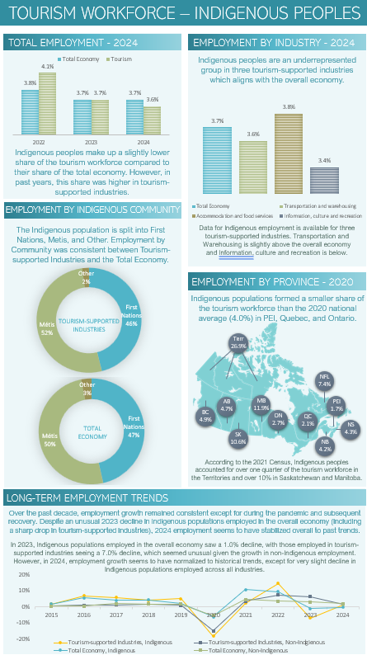
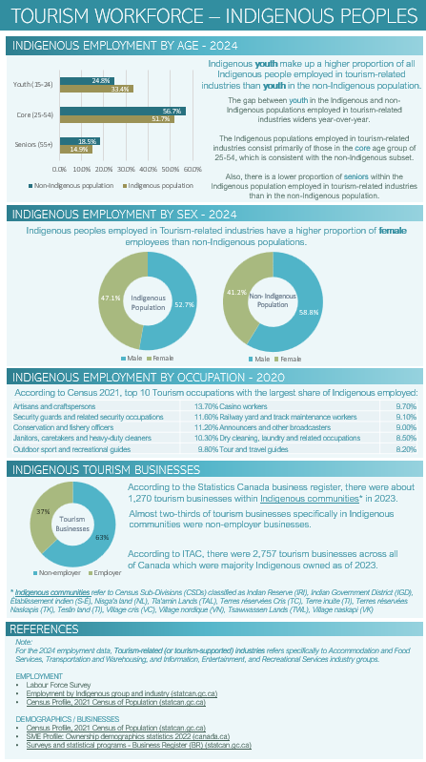
Infographics on Equity-Seeking Groups in the Tourism Labour Force
Indigenous Peoples in Tourism
Indigenous peoples make up a slightly lower share of the tourism workforce than the total economy. However, in past years, this share was higher in tourism-supported industries.
Indigenous peoples employed in Tourism-supported industries have a higher proportion of female employees than non-Indigenous populations.
Indigenous youth make up a higher proportion of all Indigenous people employed in tourism-related industries than youth in the non-Indigenous population.
Indigenous peoples accounted for over a quarter of the tourism workforce in the Territories and over 10% in Saskatchewan and Manitoba.
There were over 2,750 tourism businesses across Canada which were majority Indigenous owned as of 2023.
Note: For the 2024 Indigenous employment data, tourism-related (or tourism-supported) industries refers specifically to Accommodation and Food Services, Transportation and Warehousing, and Information, Entertainment, and Recreational Services industry groups.
13

Slide 18
QUESTIONS / FOLLOW-UP
To follow-up with questions or comments, please reach out to:
Ennio Palombizio
ennio.palombizio@ised-isde.gc.ca

